Slide 1
EDUC 15: Statistics for education research
Lecture 16
School of Education
UCI
Notes:
http://www.pewresearch.org/fact-tank/2016/11/09/why-2016-election-polls-missed-their-mark/

Slide 2
The Regression Equation with One Predictor
A bivariate or simple regression is used when one predictor variable is used to predict the criterion variable.
y’ = a + bx
Where y’ = the predicted value of the criterion variable
a = the intercept
b = the slope of the regression line
x = the value of the predictor variable

Slide 3
Multiple Regression
Adds predictors to “control” for additional sources of variation
Y (outcome)
Predictor 1

Slide 4
Multiple Regression
Adds predictors to “control” for additional sources of variation
y’ = a + bx
Y (outcome)
b
Predictor 1 (x)

Slide 5
Multiple Regression
Adds predictors to “control” for additional sources of variation
y’ = a + b₁x₁ + b₂x₂
Y (outcome)
b₁
b₂
Predictor 1 (x₁)
Predictor 2 (x₂)

Slide 6
Why?
Multiple regression uses additional predictors to explain more variation in the outcome variable
Increases R-squared
Increases our precision
Helps us make better predications
Reduces bias in a predictor variable
Helps us estimate a better effect
Is it now causal?

Slide 7
Consider the teacher value added example from last class
Back to stata output….

Slide 8
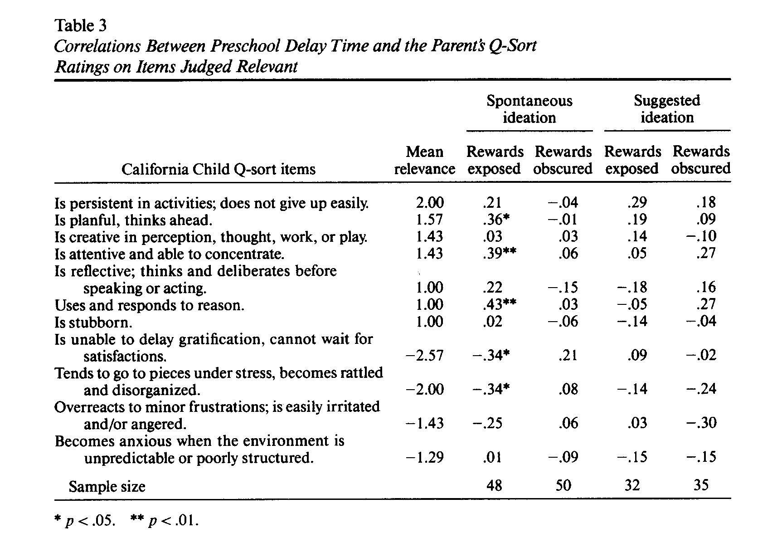
Recall the marshmallow study
From Shoda, Mischel, & Peake, 1990

Slide 9
We have tried to replicate…
Tony Quan (undergraduate) and Greg Duncan (professor)
New sample
Study of Early Childcare and Youth Development
Gratification Delay measured at age 4
Limited the sample to mothers that did not go to college
Started with bivariate regression, then added controls

Slide 10
Latest results
 |  | Achievement
 |  | First Grade |  |  | Age 15
 |  | [1] | [2] | [3] | [4] | [5] | [6]
Continuous Variable
 | Minutes Waited | 0.279 | 0.099 | 0.047 | 0.237 | 0.083 | 0.050
 |  | 0.038 | 0.033 | 0.030 | 0.037 | 0.034 | 0.032
Demographic Control
 | Male |  | 0.198 | 0.223 |  | 0.291 | 0.252
 |  |  | 0.066 | 0.061 |  | 0.066 | 0.066
 | Black |  | -0.021 | -0.130 |  | -0.066 | -0.097
 |  |  | 0.109 | 0.098 |  | 0.110 | 0.106
 | Hispanic |  | 0.025 | 0.091 |  | 0.042 | 0.169
 |  |  | 0.139 | 0.125 |  | 0.144 | 0.138
 | Other |  | 0.267 | 0.067 |  | 0.104 | 0.003
 |  |  | 0.165 | 0.149 |  | 0.163 | 0.156
 | Age in mo. |  | 0.005 | 0.043 |  | -0.045 | -0.023
 |  |  | 0.034 | 0.031 |  | 0.034 | 0.033
 | Log of Income |  | 0.064 | 0.020 |  | -0.003 | -0.031
 |  |  | 0.051 | 0.046 |  | 0.051 | 0.049
 | Mother's Age |  | -0.022 | 0.010 |  | 0.027 | 0.032
 |  |  | 0.038 | 0.034 |  | 0.038 | 0.037
 | PPVT Score |  | 0.110 | 0.045 |  | 0.154 | 0.097

Slide 11
In-Class Practice
Do effects generated from regression analyses with control variables allow for causal interpretation?
Yes
No
Maybe

Slide 12
Do these equal causal effects?
Causal effects typically generated from random variation
If we randomly assign people to one of two groups, we assume that the random assignment produces groups that are, on average, the same in every way
Only the experimental manipulation will differ
To generate causal effects off of non-experimental data, you have to control for everything that could be a confounder
We can neve really achieve this

Slide 13
Key Concepts
Sampling
Population vs sample
Goals of sampling
Describing Data
How best to describe central tendency and variation
Outliers
Central Limit Theorem
Sampling distribution of sample means
Standard error of the mean
Sampling error
Law of large numbers
Tanner: Chapter 4 and 5
Caldwell Chapter (on Canvas)

Slide 14
Key Concepts
Normal distributions
Interpret histograms
Standard normal (z curve)
Properties of a normal curve
Decision Errors
Type I vs Type II errors
How do we decrease our likelihood of making these errors?
Know your tests
If I describe a problem, know which test to you and how to make a decision regarding statistical significance
Correlations and regression
Scatter plots
How do we interpret a correlation coefficient vs a regression coefficient (i.e., slope)
What does it mean to control for another variable (i.e., multiple regression interpretation)

Slide 15
Procedural Stuff
Know how to perform the tests we have done
Z-test
1 sample t-test
Independent samples t-test
ANOVA
Calculate a correlation coefficient
Find slope and y-intercept in regression
Make predictions using regression and interpret residuals
Teacher value-added models
Review normal distribution problems (chapter 4)
Find where someone’s score falls on the normal curve

Slide 16
How to study
Read!
Tanner Chapters (all the chapters are important)
Go over your assignment
Go over the extra questions listed at the end of Tanner chapters
Get together and review with classmates!

Slide 17
Consider this quote from Hal Varian (Google’s chief economist)….
I keep saying the sexy job in the next ten years will be statisticians. People think I’m joking, but who would’ve guessed that computer engineers would’ve been the sexy job of the 1990s? The ability to take data–to be able to understand it, to process it, to extract value from it, to visualize it, to communicate it–that’s going to be a hugely important skill in the next decades, not only at the professional level but even at the educational level for elementary school kids, for high school kids, for college kids. Because now we really do have essentially free and ubiquitous data. So the complimentary scarce factor is the ability to understand that data and extract value from it.
I think statisticians are part of it, but it’s just a part. You also want to be able to visualize the data, communicate the data, and utilize it effectively. But I do think those skills–of being able to access, understand, and communicate the insights you get from data analysis–are going to be extremely important. Managers need to be able to access and understand the data themselves.

Slide 18
What is the point?
Understanding statistics has become increasingly important.
School districts need people that can help answer questions using data
This class introduced you to the tools (descriptive statistics, inferential statistics tests).
Even if you don’t go into this work, you still need to know how to consume information
https://youtu.be/mJ63-bQc9Xg?t=3m4s

Slide 19
Learn to think like a statistician
Be skeptical.
Ask about the base rate?
How common is this?
Keep track of the details but see the bigger picture
Especially important when interpreting historical data

